Slide 1
Rwanda Revenue Authority Bid
Group 3C1: Heather Mataruse, Diana Imali Luvandale, Lavina Kathambi, Ian Wanjohi

Slide 2
Agenda
Problem Statement
Dataset
Data Analysis
Recommendations
Timeline
Budget
Risks
Conclusion

Slide 3
Context
The Rwanda Revenue Authority (RRA) is a financial services institution located in Kigali Rwanda. Their mandate is to collect tax revenue on behalf of the Republic of Rwanda. Due to the prevailing COVID-19 pandemic, its tax collection figures for the 2020-2021 fiscal year deteriorated by over 10% to a value of $1.3 Billion. They are now planning in advance to improve their fiscal tax revenue for 2021-2022. A key goal of theirs is to invest in digital transformation. In line with their digital agenda, the institution is planning to establish an effective revenue collection platform to influence their decision making processes. They want to gain better insights from the vast amount of data they collect daily as well as from the media and other platforms. RRA published a Request for Proposal(RFP) which was submitted to tech companies that specialize in data analytics.

Slide 4
Problem Statement
Due to the harsh economic realities of the COVID-19 pandemic, the RRA has seen its tax revenue for the 2020-2021 financial year fall by 10% to $1.3 Billion. To improve their tax revenues, they plan to invest in digital transformation and establish an effectual revenue collection platform to help influence their decision making and gain better insights from their data.

Slide 5
Data-set Used
African crises dataset: This dataset contains numerous metrics, such as exchange rate against the dollar, annual inflation rate and domestic debt and classifies whether an African country is in a debt crisis or not.
Data tax revenue: Contains the tax revenue and types of taxes(indirect taxes, direct taxes, corporate tax, individual tax, trade tax, resource tax) of countries in Africa from 1980 until 2010.

Slide 6
Guiding Questions
Questions for consideration
Which category collects the most revenue?
Which category collects the least revenue?
What is the Rwandan situation compared to the other countries?
Which Country had the highest revenue collected?
What trends can be derived from the data?

Slide 7
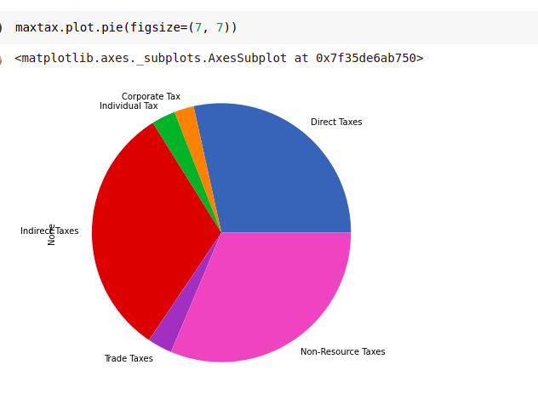
Data Analysis (Rwanda)
Maximum taxes
Direct Taxes 85.81
Corporate Tax 7.40
Individual Tax 9.00
Indirect Taxes 95.54
Trade Taxes 9.30
Resource Taxes NaN
Non-Resource Taxes 94.60
dtype: float64

Slide 8
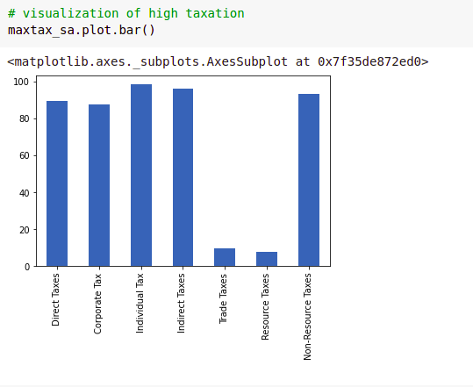
Data Analysis (South Africa)
Maximum taxes
Direct Taxes 89.44
Corporate Tax 87.66
Individual Tax 98.50
Indirect Taxes 95.91
Trade Taxes 9.62
Resource Taxes 7.72
Non-Resource Taxes 93.04
dtype: float64

Slide 9
Recommendation
Increase in individual tax collection. In comparison to South Africa, who is the highest performing country in tax collection, South Africa got its biggest tax revenue from Individual tax at 98.50%, we recommend the Rwandan Government to boost its tax collection in this sector.
Averaging the tax collection channels. Based on the dataset, there are extreme highs and lows, averaging the tax generation to about 75 95% would greatly boost the collection
[1] Inflation, factors that lead to high levels of inflation like when the demand for goods and services in an economy rises more rapidly than an economy's productive capacity can be mitigated, as based on South Africa’s tax revenue, their low level of inflation has resulted in a higher value of the South African Rand, which promotes an overall healthy economy, boosting money circulation and revenue collection more secondary this mentoring the recommendation of Increasing individual tax, there are some disadvantages to this, as highlighted below.

Slide 10
Solution Timeline
Model the data
Find significant patterns and trends using statistical methods and construct models to forecast and predict.
Gather data
We gather relevant data and key research
Week 3
Week1
Week 2
Data Cleaning
Clean data to a format the machine can interpret.
Come up with analysis /interpreting
Interpret the patterns and trends obtained and present our insights.

Slide 11
Solution Budget
Our pricing is entirely on individual service charges for the freelancers that make up the team. On average they charge an hourly fee of between $30 - $40 dollars per hour. Working for three weeks, at a total of 30 hours a week, totalling 90 hours will require an approximate budget of $10800.

Slide 12
Risk
Following the recommendation of Increasing individual tax, there are some disadvantages to this, as highlighted below.
When taxation is increased, consumer spending decreases simply because tax takes money from consumers making them have less disposable income.
With lesser disposable income, business revenue is decreased, which affects a ton of areas including hiring investment, which increases the rate of unemployment but overall, the lesser profits businesses make, the lesser tax they will pay which overall inhibits economic growth.

Slide 13
Conclusion
From our data analysis concerning the types and amounts of tax revenues collected across Africa, we were able to draw meaningful conclusions and come up with meaningful recommendations we believe can help RRA in their digital transformation mandate and establish an effectual revenue collection platform.
The analysis has proven facts based on the data given which has informed the making of data driven decisions. The pros outweigh the cons in which we do recommend that The Rwanda Government adapt to our recommendations.

Slide 14
Appendix
Links for our project:
African Crises Dataset: Here
Data Tax Revenue Spreadsheet : Here
GitHub Repository: Here

Slide 15
The End.

